Slide 1
Assignment 1 Data Set: Road Network
詹英鴻 江承陽 蔡秉宏 翁湘雲

Slide 2
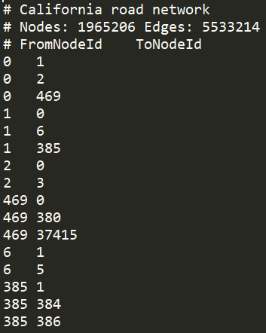
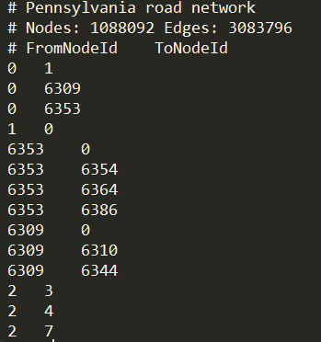
Data Set
roadNet-CA
(road network of California)
roadNet-PA
(road network of Pennsylvania)

Slide 3
Average Degree
Road network of California
Nodes :1,088,092
Degrees : 3,083,796
Average Degree :
3083796/1088092 = 2.834
Road network of Pennsylvania
Nodes :1,965,206
Degrees : 5,533,214
Average Degree :
5533214 /1965206 = 2.815

Slide 4
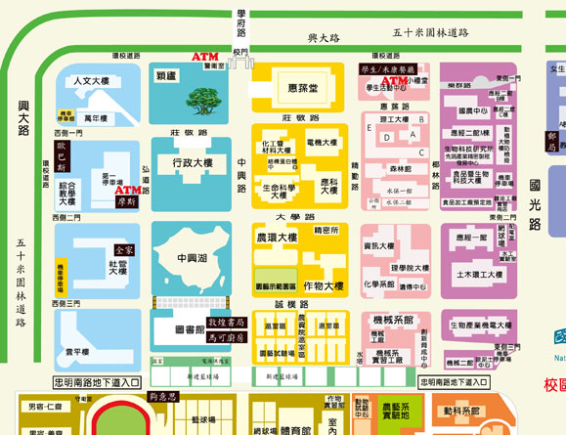
2
3
3
3
3
2
4
4
3
3
4
3
4
4
4
4
3
Nodes: 29
Degrees : 94
Average Degree: 3.24
3
4
4
4
4
3
2
3
3
3
3
2

Slide 5
Average clustering coefficient
Road network of California
Nodes :1,088,092
Total clustering coefficient : 91,127.13
Average clustering coefficient :
91127.13/1088092 = 0.04637
Road network of Pennsylvania
Nodes :1,965,206
Total clustering coefficient : 50,570.99
Average clustering coefficient :
50570.99 /1965206 = 0.04647

Slide 6
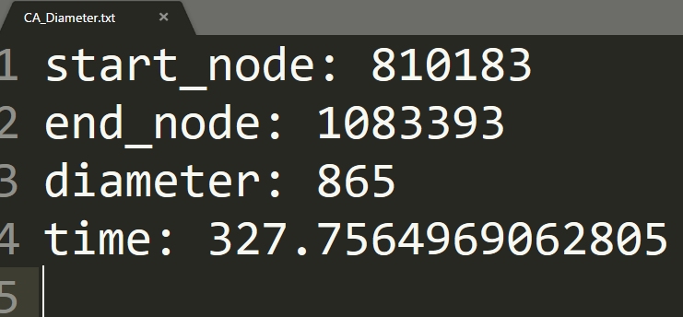
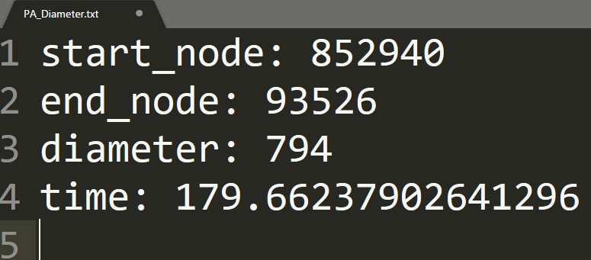
Diameter (BFS)
Road network of California
Nodes :1,088,092
Total clustering coefficient : 91,127.13
Average clustering coefficient :
91127.13/1088092 = 0.04637
Road network of Pennsylvania
Nodes :1,965,206
Total clustering coefficient : 50,570.99
Average clustering coefficient :
50570.99 /1965206 = 0.04647

Slide 7
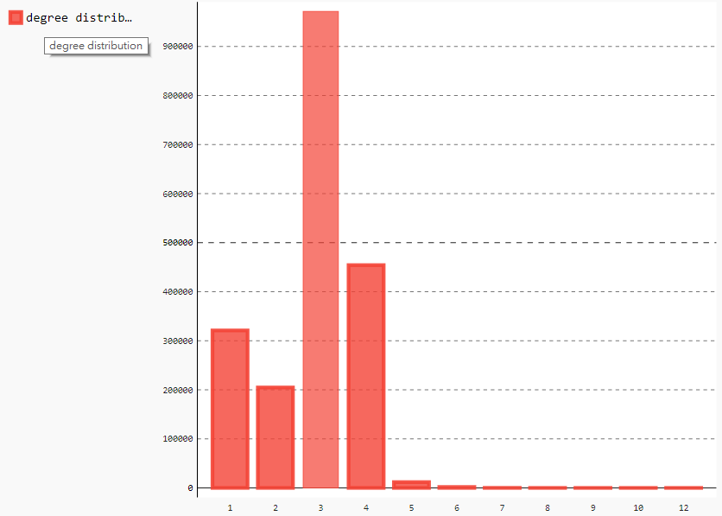
Degree Distributions ( California )
Degree | Number
1 | 321031
2 | 204754
3 | 971276
4 | 454209
5 | 11847
6 | 1917
7 | 143
8 | 30
9 | 1
10 | 2
12 | 1

Slide 8
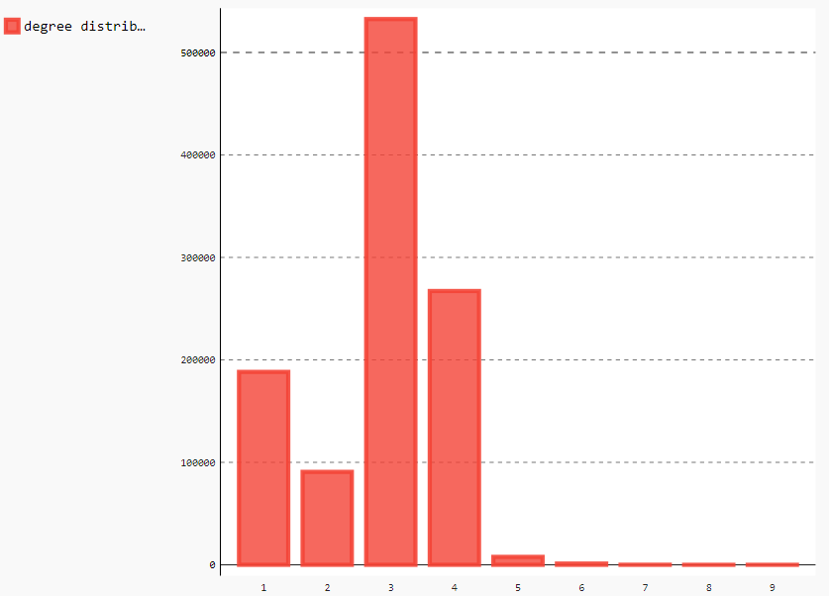
Degree Distributions ( Pennsylvania )
Degree | Number
1 | 188317
2 | 90740
3 | 532686
4 | 267256
5 | 7759
6 | 1237
7 | 80
8 | 13
9 | 4

